Slide 1
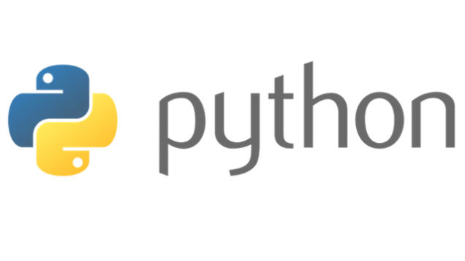
Course Id :INT 213

Slide 2
Data Visualization
When data is shown in the form of pictures, it becomes easy for the user to understand it.
Representing the data in the form of pictures or graphs is called ‘data visualization’.
Matplotlib is the "grandfather" library of data visualization with Python.
For this purpose, we can use pyplot submodule of the matplotlib module.

Slide 3
Matplotlib
It is an excellent 2D and 3D graphics library for generating scientific figures.
Some of the major Pros of Matplotlib are:
Generally easy to get started for simple plots
Support for custom labels and texts
Great control of every element in a figure
High-quality output in many formats
Very customizable in general

Slide 4
Matplotlib
Matplotlib allows you to create reproducible figures programmatically. Let's learn how to use it! Before continuing this lecture, I encourage you just to explore the official Matplotlib web page:
http://matplotlib.org/
Installation
You'll need to install matplotlib first with either:
conda install matplotlib
or
pip install matplotlib

Slide 5
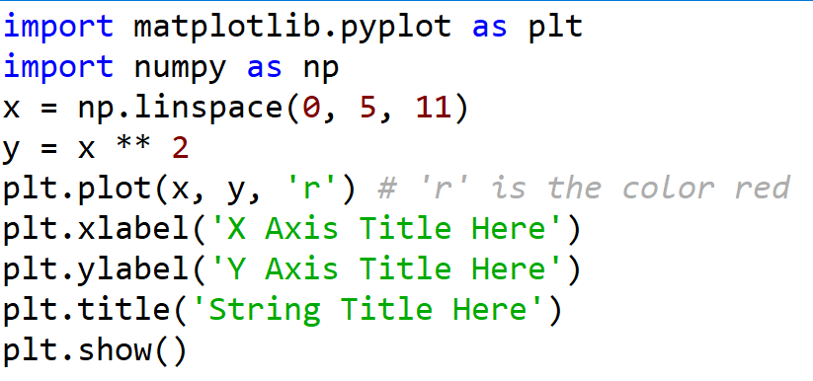
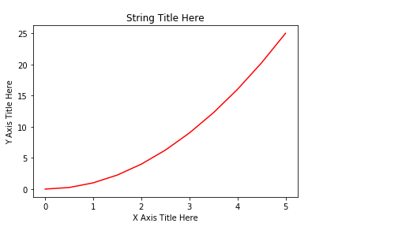
Line Graph

Slide 6
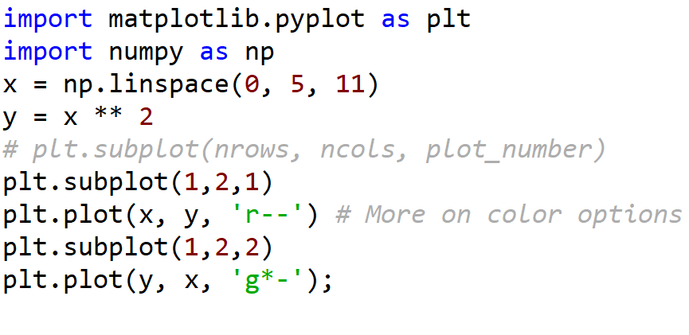
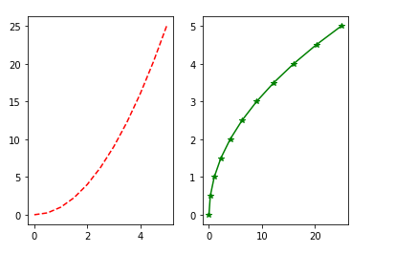
Creating Multiplots on Same Canvas using subplot()

Slide 7
Legend Function
The legend function takes an optional keyword argument loc that can be used to specify where in the figure the legend is to be drawn. The allowed values of loc are numerical codes for the various places the legend can be drawn.
ax.legend(loc=1) # upper right corner
ax.legend(loc=2) # upper left corner
ax.legend(loc=3) # lower left corner
ax.legend(loc=4) # lower right corner

Slide 8
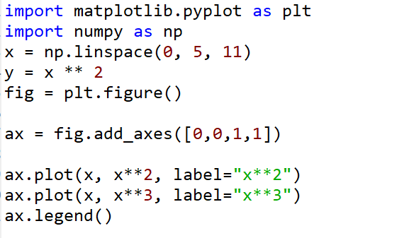
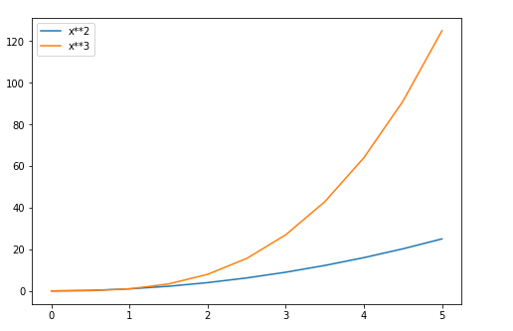
Legend Function

Slide 9
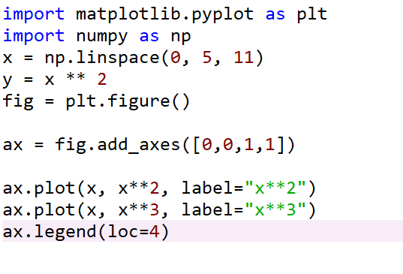
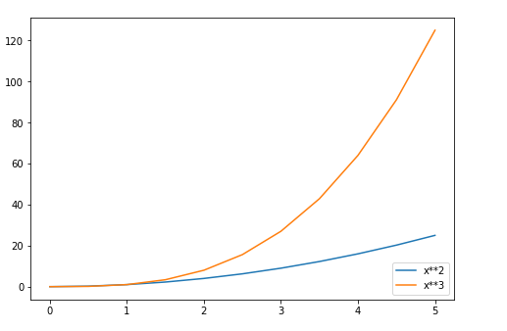
Legend Function

Slide 10
Bar Graph
A bar graph represents data in the form of vertical or horizontal bars. It is useful to compare the quantities.
Now, let us see how to create a bar graph with employee id numbers on X-axis and their salaries on Y-axis.

Slide 11
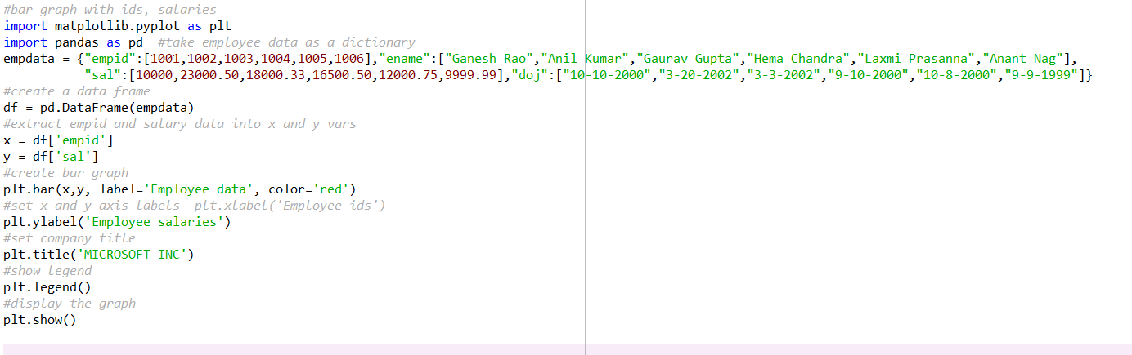
A Python program to display employee id numbers on X-axis and their salaries on Y-axis in the form a bar graph.

Slide 12
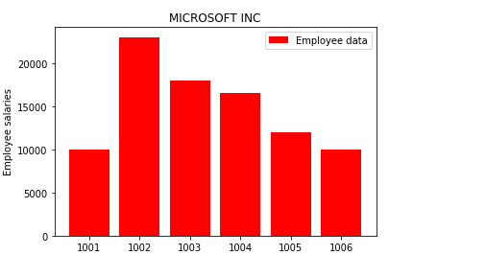
Output

Slide 13
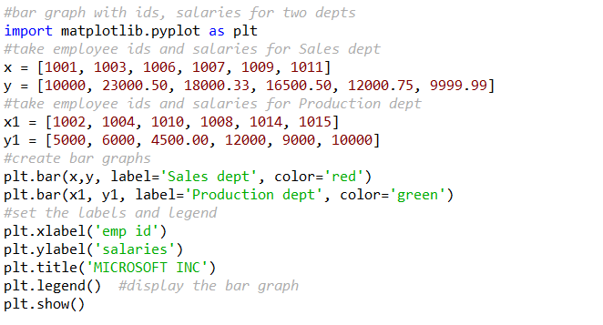
A program to display employee id numbers on X-axis and their salaries on Yaxis in the form of a bar graph for two departments of a company.

Slide 14
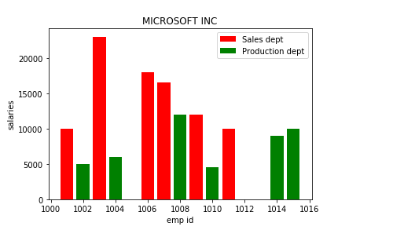
Output

Slide 15
Histogram
Histogram shows distributions of values.
Histogram is similar to bar graph but it is useful to show values grouped in bins or intervals.
For example, we can collect the age of each employee in a company and show it in the form of a histogram to know how many employees are there in the range of 0-10 years, 10-20 years, etc.

Slide 16
Histogram
For this
emp_ages = [22,45,30,59,58,56,57,45,43,43,50,40,34,33,25,19]
bins = [0,10,20,30,40,50,60] #of 10 years’ range
The bins list contains 0,10,20... This indicates the ranges from 0 to 9, 10 to 19, etc., excluding the outer limit.

Slide 17
Histogram
To draw the histogram, we should use hist() function as:
plt.hist(emp_ages, bins, histtype='bar', rwidth=0.8, color='cyan’)
Here, histtype is ‘bar’ to show the histogram in the form of bars.
The other types can be ‘barstacked’, ‘step’, ‘stepfilled’.
The option rwidth = 0.8 indicates that the bar’s width is 80%.
There will be a gap of 10% space before and after the bar.
If this is decreased, then the bar’s width will be narrowed.

Slide 18
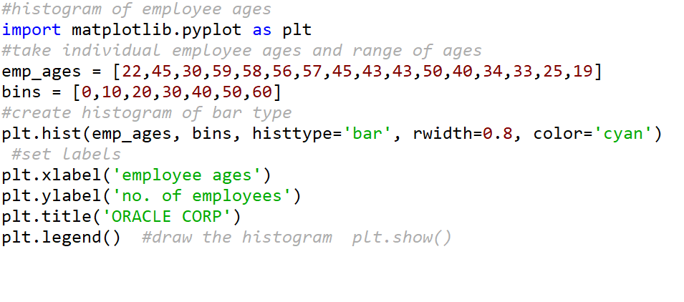
A program to display a histogram showing the number of employees in specific age groups.

Slide 19
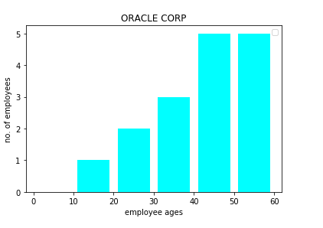
Output

Slide 20
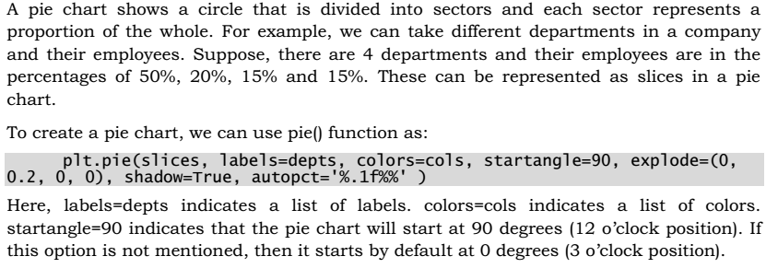
Pie Chart

Slide 21
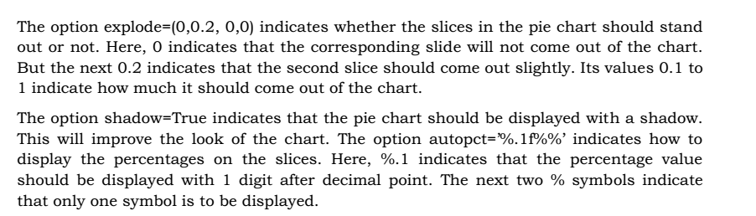
Pie Chart

Slide 22
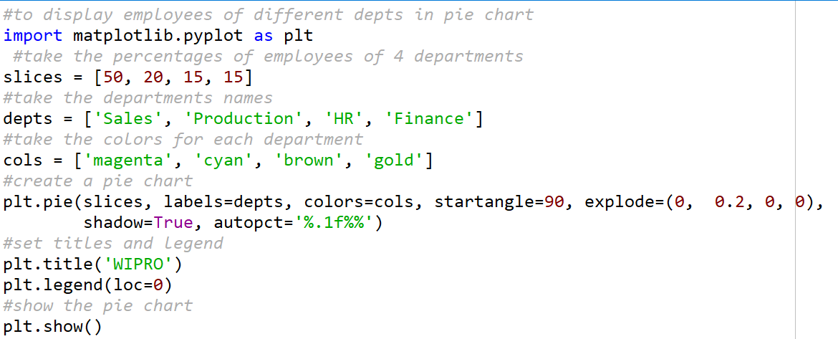
A program to display a pie chart showing the percentage of employees in each department of a company.

Slide 23
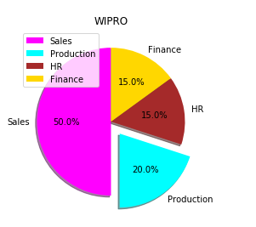
Output

Slide 24
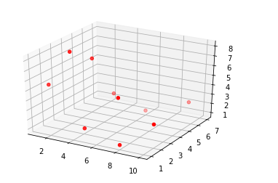
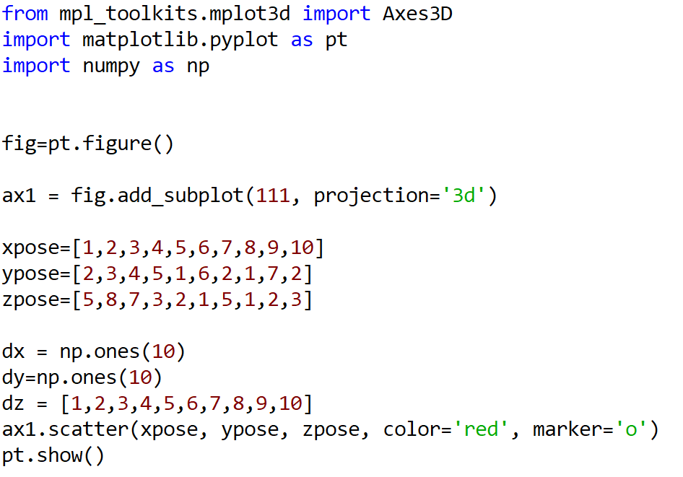
Scatter

Slide 25
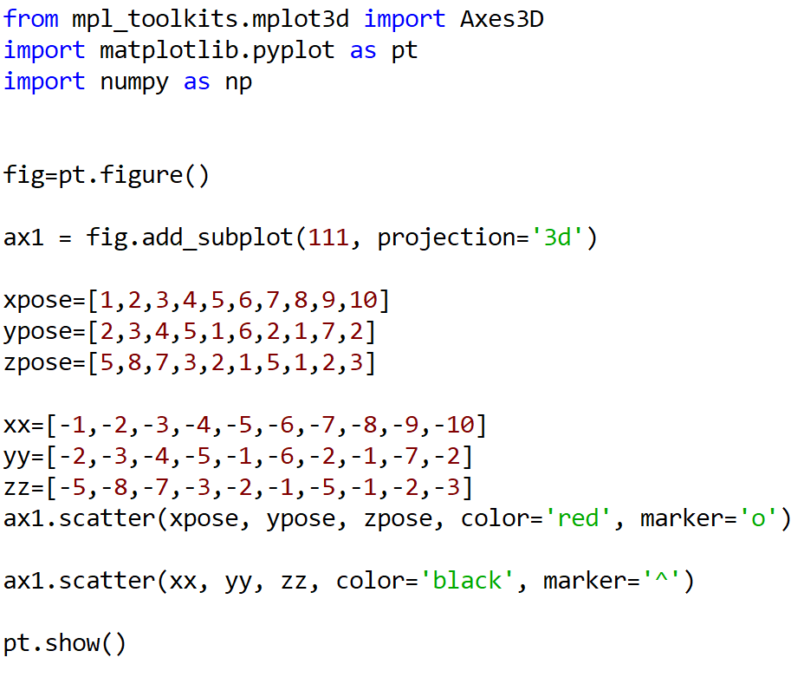
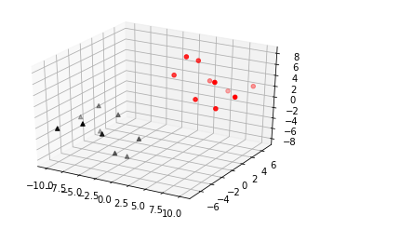
Multiple Scatter

Slide 26
Introduction to Object Oriented Method
Oriented method is to create figure objects and then just call methods or attributes off of that object.
This approach is nicer when dealing with a canvas that has multiple plots on it.
To begin we create a figure instance.
Then we can add axes to that figure.

Slide 27
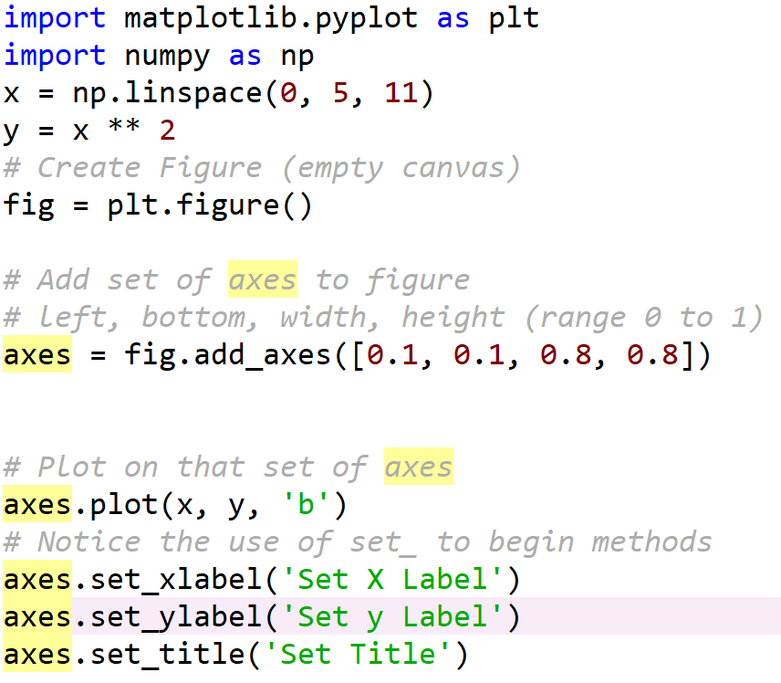
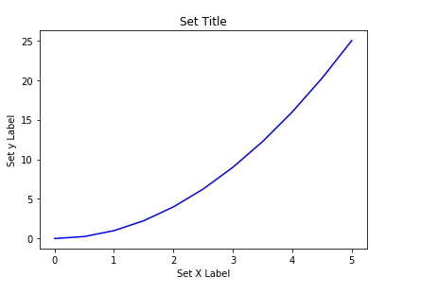
Object Oriented Method

Slide 28
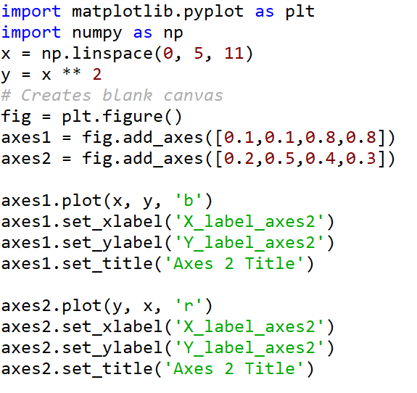
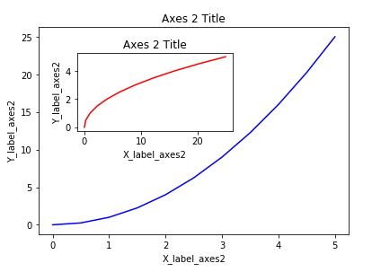
Object Oriented Method

Slide 29
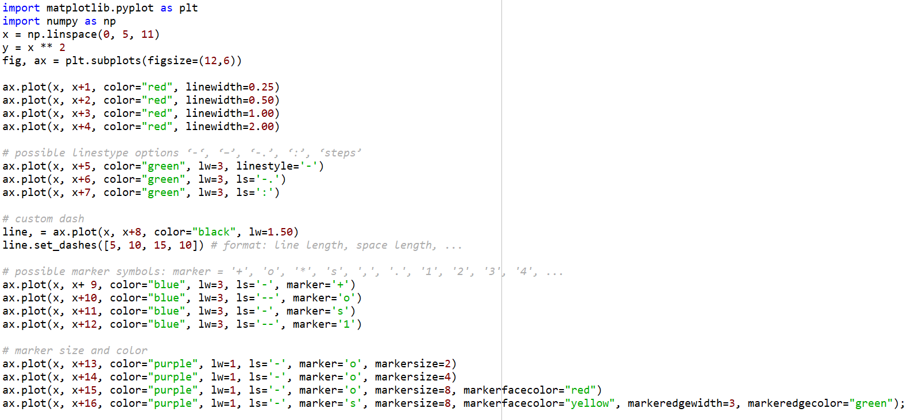
Line and marker styles

Slide 30
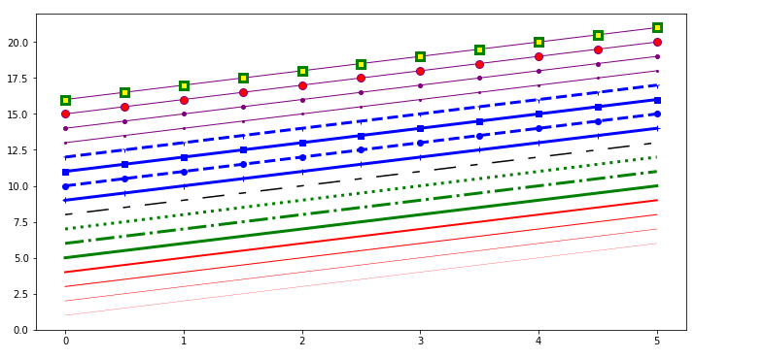
Line and marker styles

Slide 31
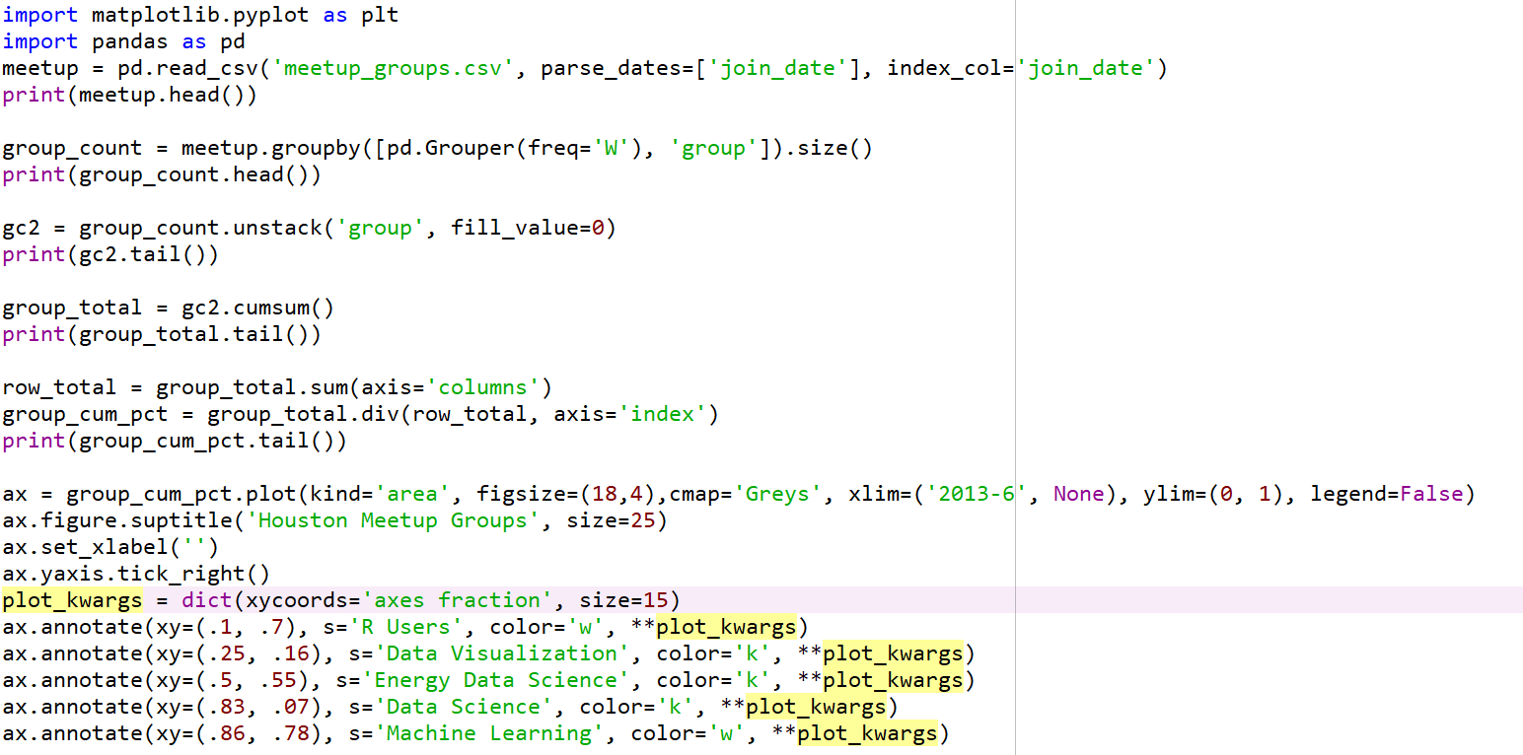
CSV file

Slide 32
